Slide 1
WorldVisitz Mobile Application Agile Delivery Launch
Agile Foundations - Presentation for the Leadership Team
Presented by: Okba Zebir
© 2019 Udacity. All rights reserved.

Slide 2
Part 1: How WorldVisitz Can Benefit From Agile

Slide 3
What is Agile?
Agile methodology is a project management and software development framework that breaks projects into sprints, a collection of best practices that involve collaboration, feedback loops from a real customer, test-driven development, self-organization, and short delivery times to deliver the right product.
Agile enables organizations to predictably deliver value in a world where we are constantly being challenged with Volatility, Uncertainty, Complexity, and Ambiguity.
Agile core values are Individuals and interactions over processes and tools by placing importance and emphasis on people and their interactions over processes and even tools, Working software over comprehensive documentation, Customer collaboration over contract negotiation by working with customers in reaching an agreement on the details of the product delivery and Responding to changes over following a plan by embraces the change that makes business sense.
Organizations that go through Agile benefit from; Building the right products, Early risk reduction, Faster time to market, and Early ROI .

Slide 4
What is Agile manifesto?
The Agile Manifesto’s 4 paired core values drive the 12 Agile Principles are :
Our highest priority is to satisfy the customer through the early and continuous delivery of valuable software.
Welcome changing requirements, even late in development. Agile processes harness change for the customer's competitive advantage
Deliver working software frequently, from a couple of weeks to a couple of months, with a preference to the shorter time scale
Business people and developers must work together daily throughout the project
Build projects around motivated individuals. Give them the environment and support they need, and trust them to get the job done.
The most efficient and effective method of conveying information to and within a development team is face-to-face conversation.
Working software is the primary measure of progress.
Agile processes promote sustainable development. The sponsors, developers, and users should be able to maintain a constant pace indefinitely.
Continuous attention to technical excellence and good design enhances agility.

Slide 5
Simplicity - the art of maximizing the amount of work not done - is essential.
The best architectures, requirements, and designs emerge from self-organizing teams.
At regular intervals, the team reflects on how to become more effective, then tunes and adjusts its behavior accordingly.

Slide 6
Key differences between Agile and Waterfall
 | Agile | Waterfall
Product Lifecycle | Iterative | Distinct phases
Design Process | Incremental | Sequential
Change | Change is embraced | Change is a challenge
Mindset/Focus | Customer needs | Completing the project
Collaboration | Significant collaboration | Limited Synchronization
Requirements | Prepared incrementally | Prepared at start of project
Organization | Self-directed team | Led by Product Manager

Slide 7
The benefits of Business Agility to WorldVisitz
Agile highest priority is to satisfy the customer through early and continuous delivery of valuable software. Frequent and iterative delivery of working products provides the business with practical feedback Built-in quality practices have enormous benefits. It allows for easier maintenance and scalability of the product. Due to the competitive landscape requirements can and will change through product development agile Welcome changing requirements, even late in development. Agile processes harness change for the customer's competitive advantage.

Slide 8
What is Agile Umbrella
Agile Umbrella is a term that refers to the various Agile Frameworks that follow the Agile Manifesto's values and principles, it has some key characteristics that deliver value, promote incremental improvement to minimize resistance from all who are involved, flexibility, trust, and respect, and cultivate mastery. There are a large number of ever-growing frameworks some are Scrum , Kanban, and XP.
Scrum is by far the most common Agile framework

Slide 9
Scrum: is by far the most common Agile framework in use across industries globally, the team manages the work with a focus on delivering complex product features. It is based on an iterative and incremental approach.
Scrum Roles: There are 3 core roles in the scrum framework
Product Owner, who is the voice of the customer.
Scrum Master, who is the key facilitator.
Agile Team, also known as the Scrum Team sometimes.
Scrum events: events or ceremonies in scrum :
Project Vision: is where the business leaders identify a business need that is intended to achieve.
Daily Stand Up: synchronizes activities and creates a short plan for the next 24 hours.
Sprint planning: the team takes the prioritized backlog by PO and plans out the work to be performed in the sprint.
Sprint Review: A meeting is held at the end of each sprint to review the work completed during the sprint.
Sprint Retrospective: A meeting is held to identify practical opportunities for improvement.
Release Planning: The team develops a plan for when a collection of functionality will be delivered to the customer.

Slide 10
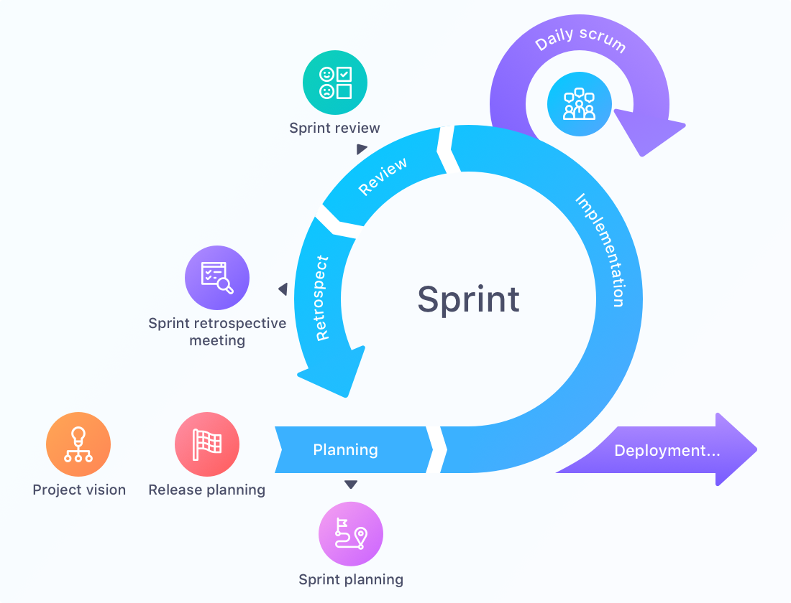
Scrum Artifacts
Product Increment clarifies what is being delivered in each increment at the end of each Sprint.
The Product Backlog is the prioritized list of work to be delivered by the Team.
The Sprint Backlog contains the prioritized items that the PO has designated for the Sprint.
Scrum Values:
Focus - Everyone in the Team focuses on the work to be completed in order to deliver the Sprint goals.
Courage - Members of the Team need to have the courage to do what is right to ensure the Sprint goals are met.
Openness - The Team and its stakeholders agree to a culture of openness.
Commitment - Commitments build trust among the Agile Team members, as well as with the business users and leaders.
Respect - Respect is key in Scrum for a high-achieving Agile Team.
SCRUM - ECLEE | European Center for Leadership and Entrepreneurship Education

Slide 11
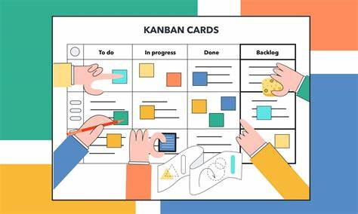
Kanban
Kanban: Its origins in lean product development for managing and improving work processes.
Principles of Kanban: is a lightweight Agile framework with 5 Principles
Visualize the flow
Limit work in progress
manage the flow
Make policies explicit
Improve Collaboratively.
Kanban Roles: doesn’t prescribe specific roles.
Kanban Event: The events are simplified and articulated in 4 events that align with 4 of the scrum event :
Project vision, Daily Stand Up, Review/Demo, and Release Planning.
Kanban Artifacts :
Kanban Board - A Kanban Board plays a valuable role since it articulates the work items in their various stages of the product development journey.
Cumulative Flow Diagram - A Cumulative Flow Diagram shows the total amount of WIP and how quickly projects are being completed.

Slide 12
XP Framework
XP: Extreme Programming is an Agile framework focused on software development, and has a strong focus on technical excellence and best practices in software development.
XP roles: includes four roles
- Customer, Tester, Coach, and Programmer.
XP events:
Iteration Planning, Iteration Review, Iteration Retrospective, Project Vision, Daily Stand Up, and Release Planning.
XP values: there are 5 XP core Values simplicity, communication, feedback, courage, and respect.

Slide 13
Part 2: The Optimal Agile Framework for WorldVisitz

Slide 14
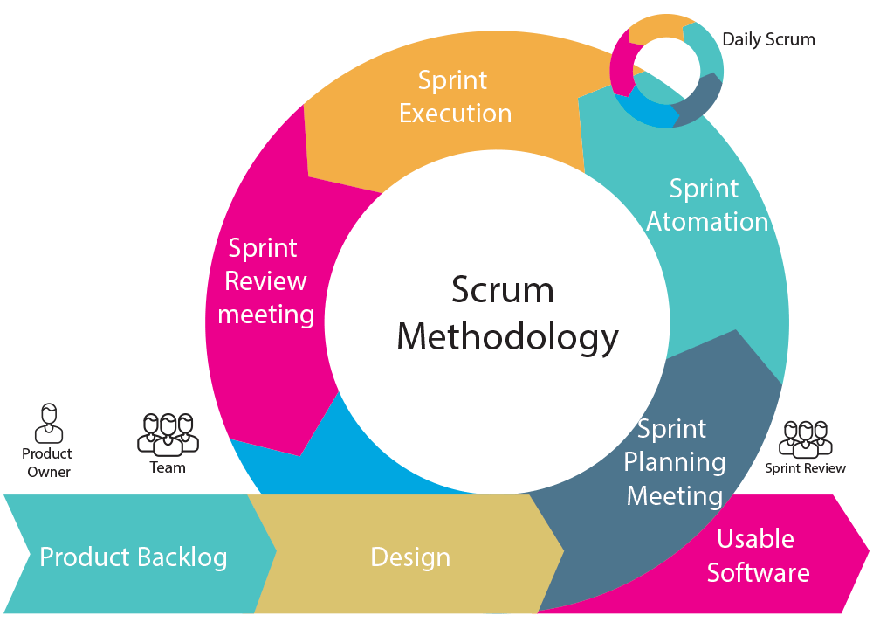
The recommended Agile Framework for WorldVisitz is Scrum
BV.studio

Slide 15
The Scrum Framework is the most suitable approach as a management method for WorldVisitz company. It can help the company to adapt the market change condition and deliver high-quality product features to meet the customer needs. Scrum provided clearly described roles and responsibilities for the team and promotes continuous improvement and collaboration between team members, and collects customer feedback in an iterative way.

Slide 16
Business challenges WorldVisitz Facing
Business Challenges | How Scrum Can Help
Lack of collaboration, and communication between team members. | Scrum focuses on collaboration and communication among team members by conducting daily stand-ups, sprint planning, and sprint review meetings. sharing knowledge through retrospective meetings.
Traditional management methods that do not support the company’s vision | Scrum works in an iterative and incremental delivery of working software in a short time that allows collecting real customer feedback in the early stage of development that can be translated to customer requirements.
Lack of knowledge transfer and coding standards. | Scrum encourages to follow the coding standards. It promotes the sharing of knowledge among cross-functional teams that is articulated through retrospective meetings.

